Slide 1
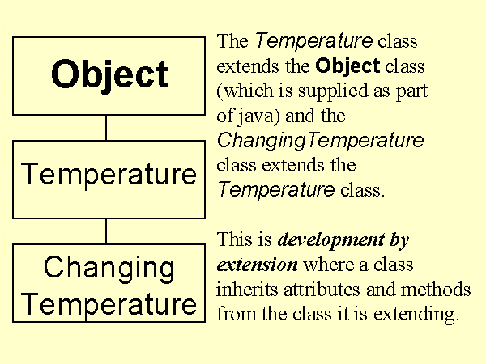
Class Hierarchy Diagram

Slide 2
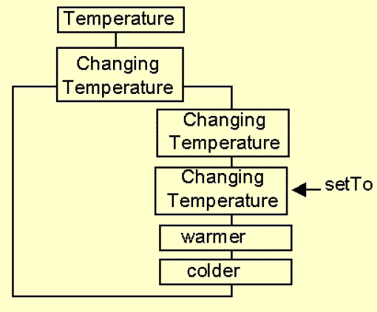
The ChangingTemperature Class Diagram

Slide 3
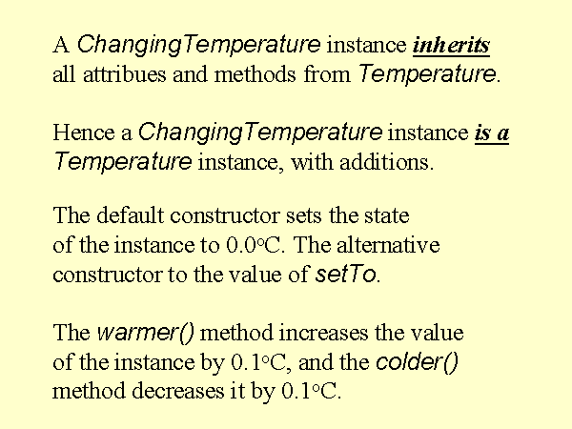
The ChangingTemperature Class

Slide 4
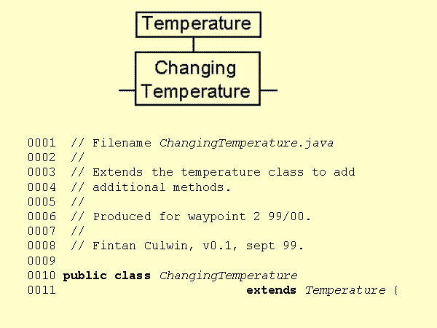
The ChangingTemperature Header

Slide 5
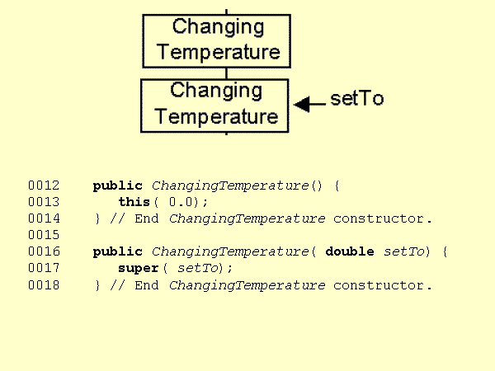
The ChangingTemperature Constructors

Slide 6
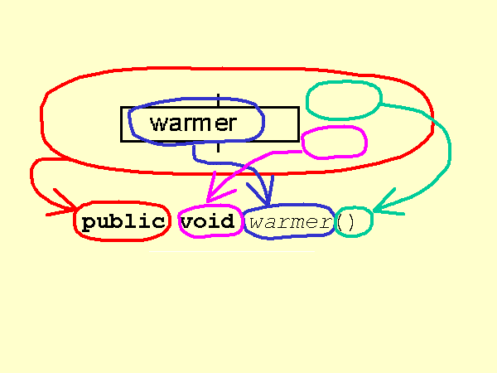
The ChangingTemperature Method Declaration

Slide 7
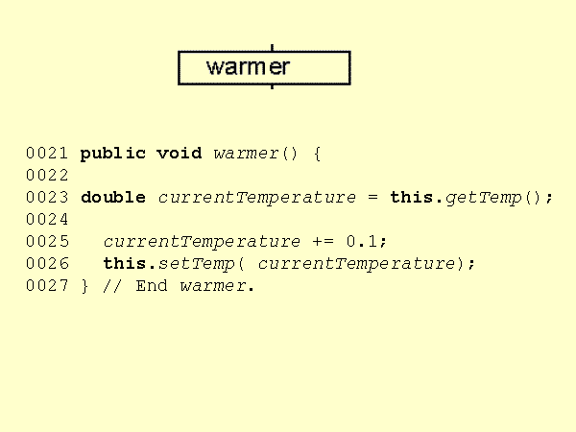
The ChangingTemperature warmer() definition

Slide 8
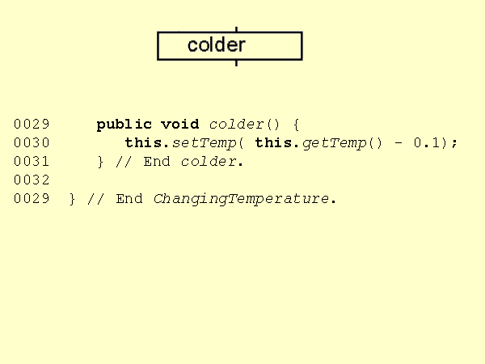
The ChangingTemperature colder() definition

Slide 9
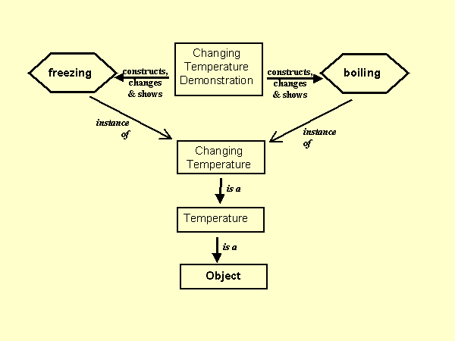
The ChangingTemperatureDemonstration program

Slide 10
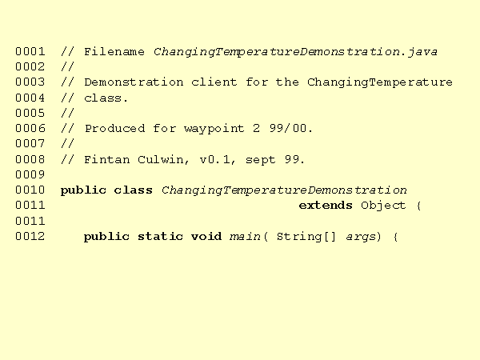
The ChangingTemperatureDemonstration header

Slide 11
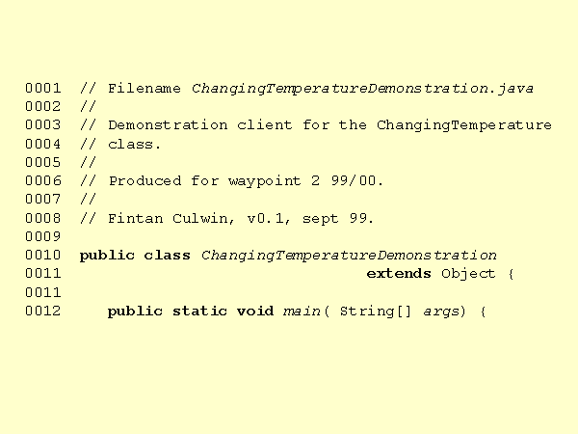
The ChangingTemperatureDemonstration part 1

Slide 12
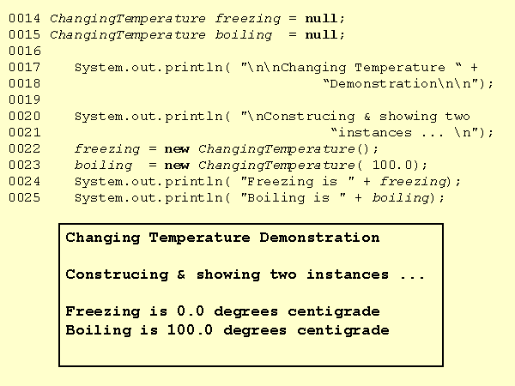
The ChangingTemperatureDemonstration part 2

Slide 13
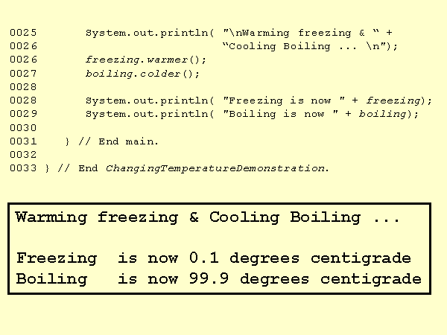
The ChangingTemperatureDemonstration part 3

